Slide 1

THE LATEST BREAKTHROUGH EXPLAINED
5th Generation Technology
Learn how 5G is changing the world of communication

Slide 2

5G Technology: What You Need to Know
UNDERSTAND HOW THE NEW NETWORK WORKS
5G Defined
Speed and Efficiency
The Difference in Communication
Accessibility
Where 5G Is Used
Economic Impact

Slide 3

5G Defined
5G is short for the 5th generation mobile network. The latest global wireless standard following 1G to 4G networks, 5G technology enhances communication through seamless virtual connections: people, machines, objects, devices.

Slide 4
Before 5G Technology
With 5G Technology
The pre-5G internet experience was slower and limited to certain spectrum types.
5G technology's design includes an impressive increase in network efficiency and traffic capacity.
Previous mobile network generations
did not entirely support new services
that rely heavily on communications.
It is designed to support all spectrum types, bands, and deployment models.
There were significantly more issues and limitations to availability and reliability.
5G guarantees high speeds that will significantly impact every industry.

Slide 5

Mobile Networks and 5G Technology
1G
2G
3G
4G
5G
1980s
1990s
2000s
2010s
Current
A network limited to only voice call capabilities.
GSM, GPRS,
and EDGE advancements
Allowed faster communication, web browsing, and video streaming in smartphones
Greatly impacted the requirements set by
IMT-Advanced standards.
Significantly faster speeds with lower requirements
to support IoT devices

Slide 6
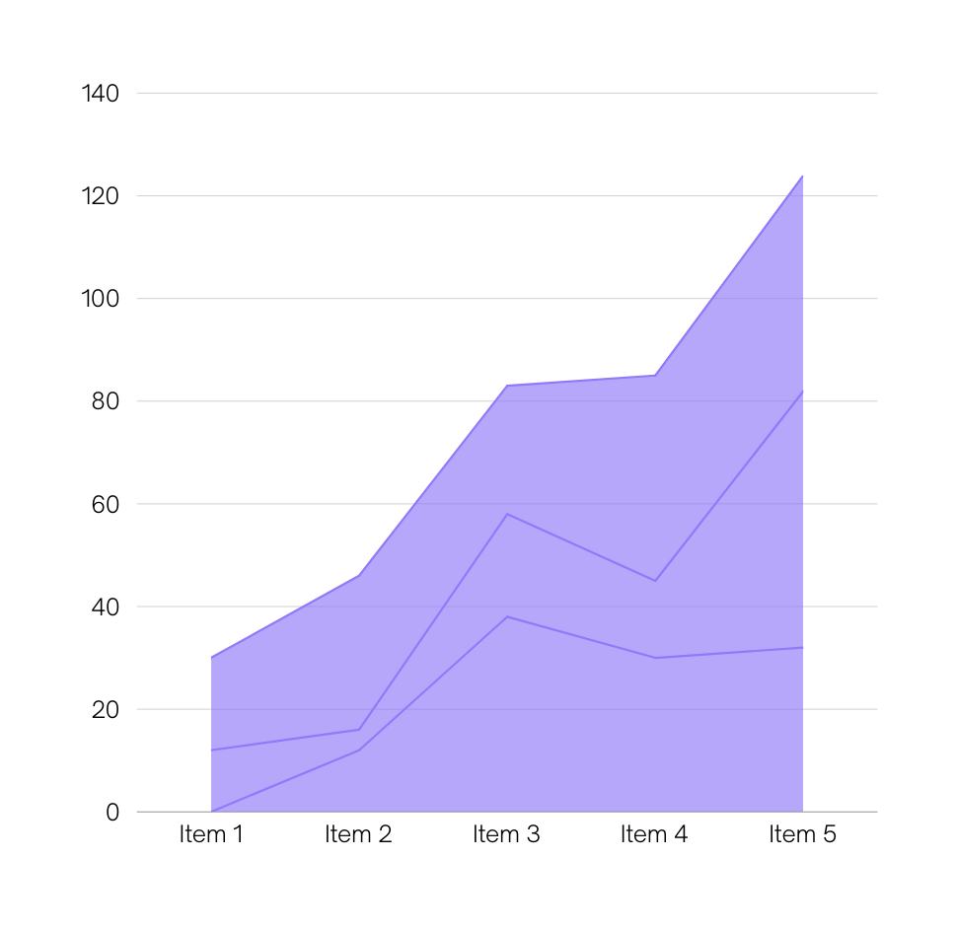
5G Technology Adoption in the World
AS OF JANUARY 2021
5G technology adoption continues to rise in more countries and cities.

Slide 7

Why 5G Is Better Than 4G
THE NEXT GENERATION OF WIRELESS TECHNOLOGY
THAT WILL TRANSFORM LIFE SIGNIFICANTLY
5G technology guarantees a faster and smoother transmission of data, no matter how high the amount. Users can look forward to faster downloads and better support for more connected devices.

Slide 8
The Benefits
of 5G Technology

Slide 9
Benefits for Businesses
5G technology can support operations to improve processes, produce better results, and remain at the top of their game
No network issues
Lower latency
Greater data capacity
5G will bring a connection speed that's significantly faster than 4G, meaning more data transfer in less time, promising results without delay.
Lower latency will improve IoT devices' safety and functionality, allowing real-time viewing and guaranteeing zero lags in operations.
5G can support more devices and allow simultaneous data transfer because of its larger spectrum band.

Slide 10

Benefits in Daily Life
Elevated streaming experience
Nothing says excellent entertainment, quite like uninterrupted streaming. Thanks to 5G, we can enjoy unlimited data capacity, short lag times, and multisensory digital content.
Better coverage for smartphones
No more difficulty getting connected -- 5G brings better signal to places that were once difficult to reach. Enjoy stronger connections and better communication with 5G.
It may take years before
we experience the full potential of 5G, but that doesn't mean
we can't enjoy what it can already offer us.
Road safety
Self-driving cars will soon become the new norm. But motorists can also enjoy better data processing between vehicles and networks - that means safety on the road and improved traffic management.

Slide 11

HEALTH RISKS FROM
USING 5G, DEBUNKED
Does 5G technology really pose health risks?
As popular as 5G is becoming, many believe it is a source of cancer and COVID-19. Radiation associated with 5G is believed to cause cancer and weaken the immune system, making it susceptible to the spread of COVID-19. Experts believe both are highly unlikely to have no proven link between COVID-19 infections, cancer, and 5G networks.

Slide 12

As exciting and appealing as 5G technology is,
there are a few cons to it: its impact on battery life, high costs for rollout, and imbalance
in upload and download speeds.

Slide 13
Trends and the Future of Telecommunications
Cloud technology will allow telecoms to operate with more efficiency as this guarantees scalability and cost-effectiveness, allowing them to adjust better to market demands.
Artificial intelligence that keeps behind-the-scenes operations rolling faster will guarantee business optimization like never before.
The IoT or the Internet of Things is a technology that helps ensure minimal downtime for data centers and base stations. The telecom industry will continue to develop its services to improve IoT technology.
In-house software development is crucial in ramping up security and productivity. New software (with new tools and services that shift security efforts) will prevent any technological breach leading to systemwide failures.will guarantee business optimization like never before.
Robotic Process Automation will significantly reduce error rates and boost customer service/operational efficiency.

Slide 14

"Any sufficiently advanced technology is equivalent to magic."
SIR ARTHUR C. CLARKE

Slide 15

Do you have
any questions?
Send it to us! We hope you learned something new.

Slide 16






























Free Resources
Use these free recolorable icons and illustrations in your Canva design

